Slide 1
Guangzhou Section Jt. Chapter, EMC27/AP03
Chair: Dr./Prof. Lie Liu
Vice Chair: Dr. Tian Zhou
Secretary : Mr. Nan Li and Mr. Jiyu Wu
Term: from Dec. 2019 to Dec. 2020
Around 30 Members
Prepared by L. Liu, liulie_leo@hotmail.com

Slide 2
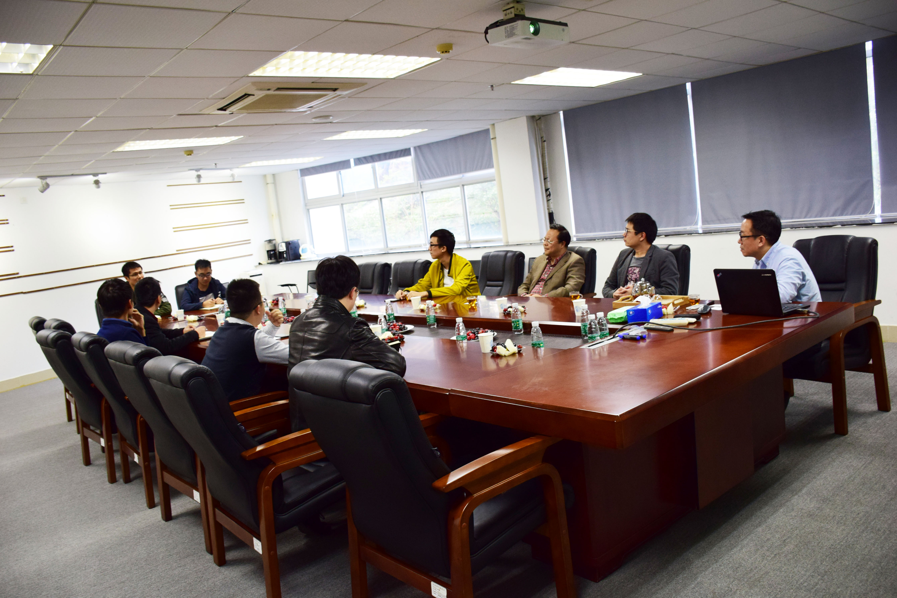
Guangzhou Section Jt. Chapter, EMC27/AP03
Establishment of the joint Chapter at General Test systems in Shenzhen, one and half years before. No EMC chapter in Bay area before!
Welcome speech by Chair
Ice-breaking
Election of executive committee, including vice chair，secretary and treasurer
Dec. 15, 2018

Slide 3
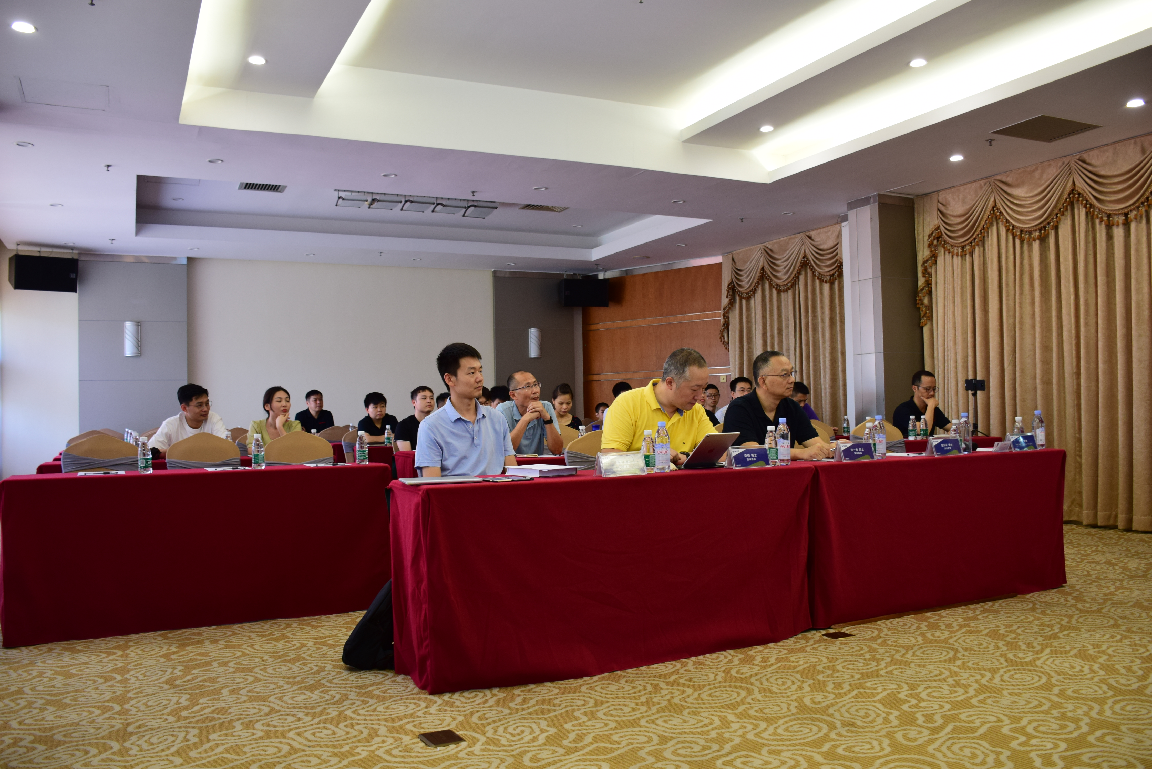
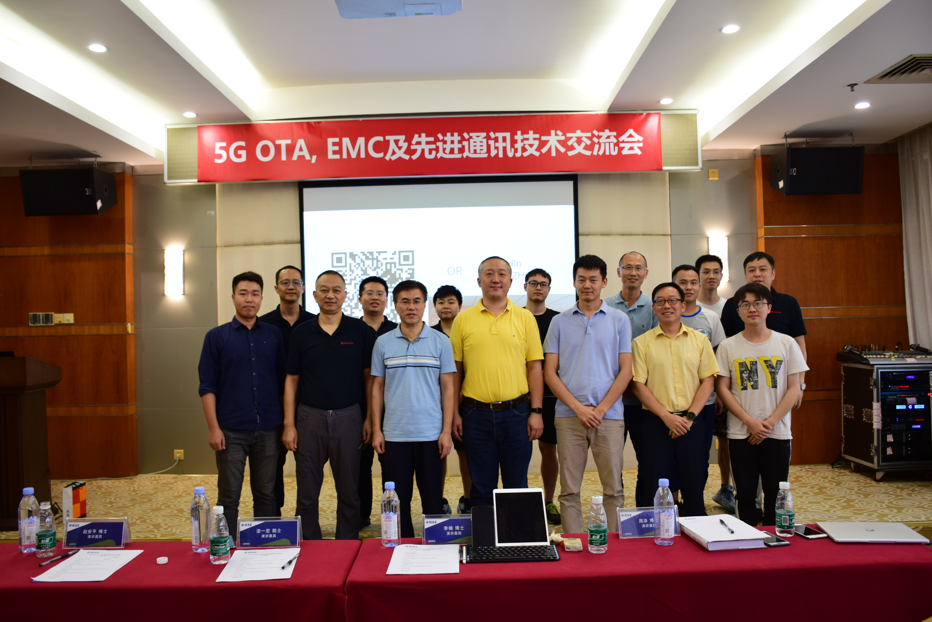
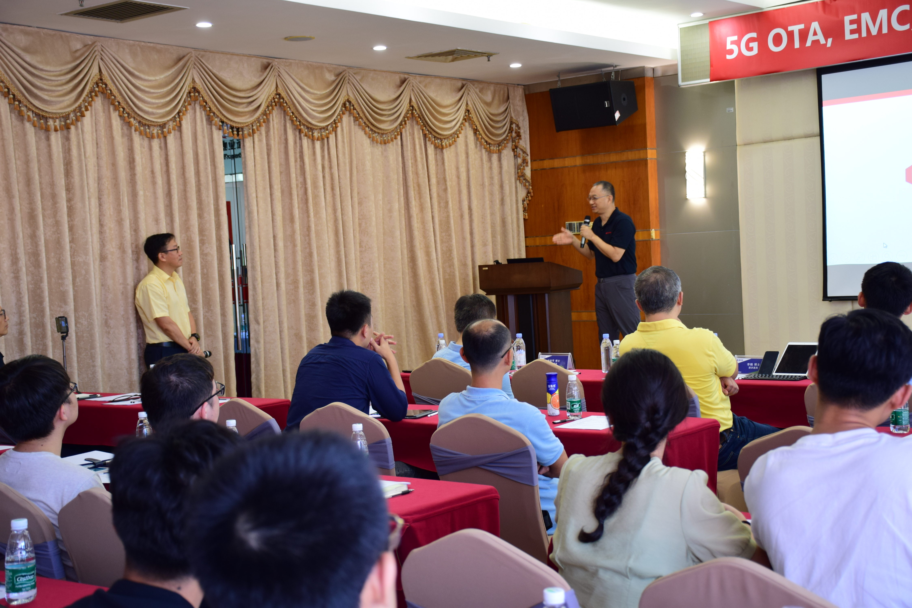
Guangzhou Section Jt. Chapter, EMC27/AP03
Hold a seminar on “5G OTA, EMC and Advanced Wireless Communication Technologies” on June 29, 2019, Four talks was given by Dr. Yihong Qi, Dr. Anping Zhao, Dr. Tian Zhou and Mr. Nan Li
June 29, 2019
Dec. 15, 2018
June 29, 2019
June 29, 2019

Slide 4
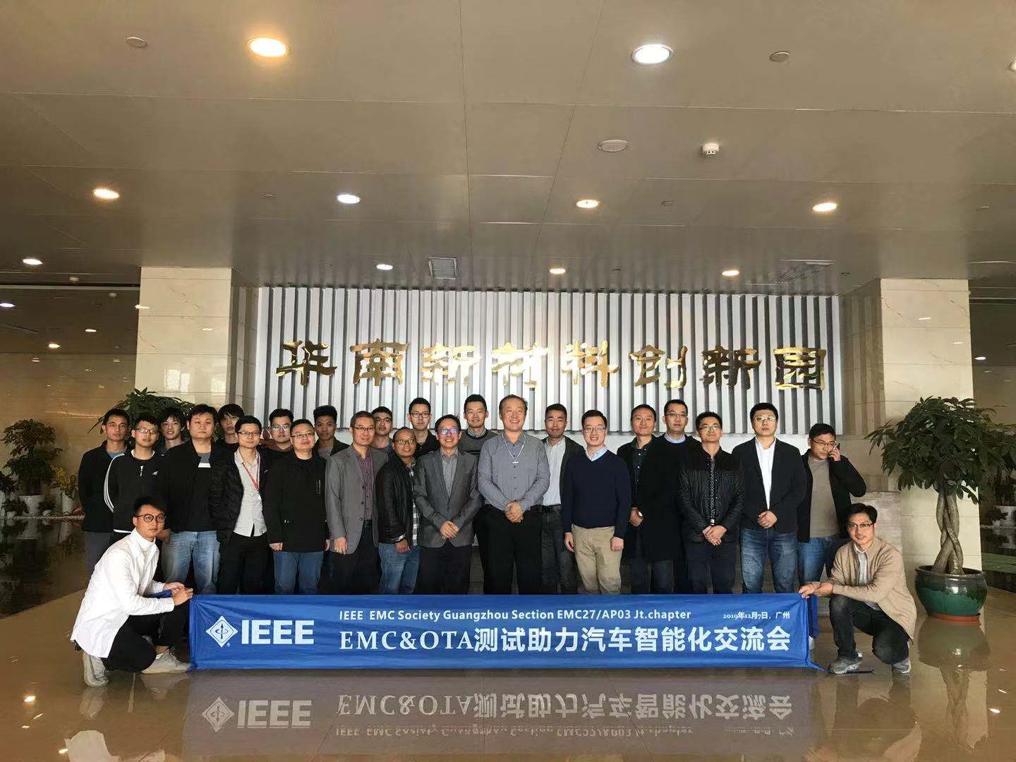
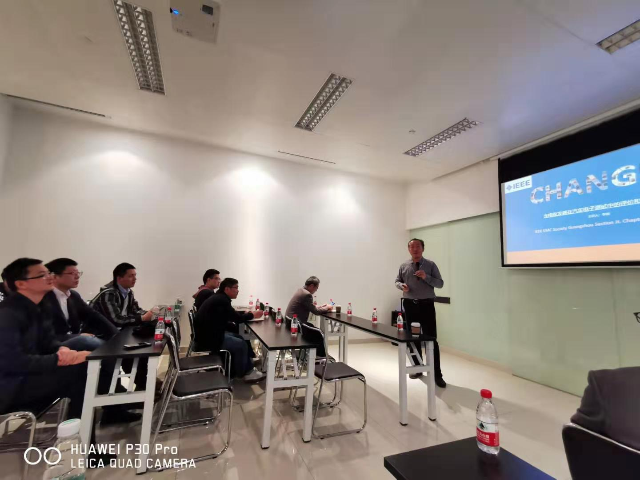
Guangzhou Section Jt. Chapter, EMC27/AP03
Hold a seminar on “EMC&OTA Test for Intelligent Vehicles” on Dec 07, 2019, four talk was given by Mr. Nan Li, Dr. Lie Liu, Mr. Jiyu Wu and Mr. Xie (TUV)

Slide 5
Summary and Future Works
The purpose of our chapter is to provide service to EMC and Wireless communication around Zhujiang Bay area, which include Guangzhou, Shenzhen, Zhuhai and few other cities.
Our chapter connects people from different cities by holding seminars, either in-person or virtual one
Our chapter bridges the gap between local society with outside by encourage them to attend annual EMC SI/PI, AP symposium, and other conferences by IEEE
Recruitment of new IEEE members, with emphasis on YP
We have WeChat group with 47 members, will plan more virtual seminars in the future.

Slide 6
Thank!
Stay Heathy and Stay Safe!

